Slide 1



It Salary Prediction(EU)
Elizabeth Shogbanmu

Slide 2
Table of contents
Data Description
Data Pipeline
Exploratory Data Analysis
Linear Regression Model
Features Importance
Limitations
Conclusion
References and Acknowledgement

Slide 3

DATA SET description
A survey conducted on respondents across Europe(1990 rows and 11 columns)
Target variable is yearly salary in Euro
Features include Age, Gender, City, years of experience, position, main technology, company type, size, etc.

Slide 4

Data Pipeline
Data collection
Data Processing
Machine Learning(Linear regression)
Improving Model(Cross Validation-Kfold)

Slide 5
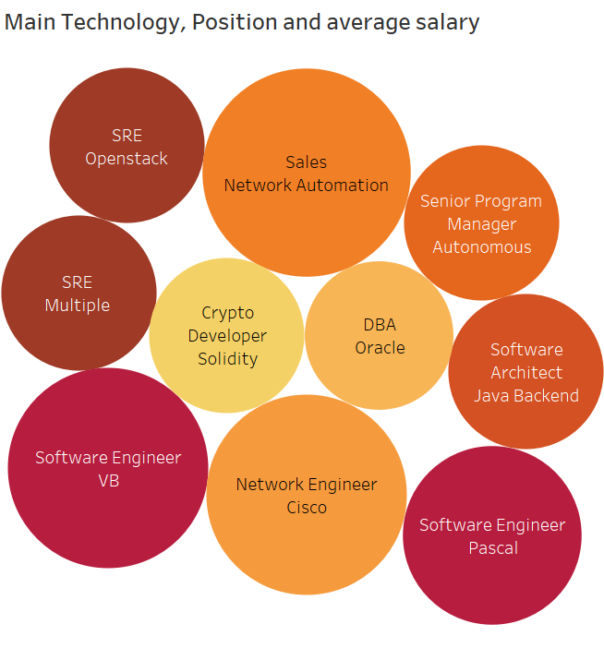
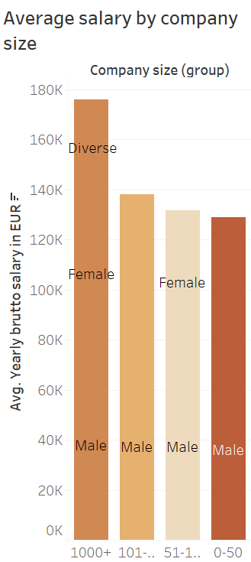
DATA VISUALISATION

Slide 6
LINEAR REGRESSION MODEL
Independent Variables
Target Variable
Building the Model

Slide 7
STATISTICS
CROSS PREDICTED ACCURACY
R2/ADJUSTED R2
MSME,
95%
92%
92%

Slide 8
Predicted vs actual values

Slide 9
FEATURES IMPORTANCE

Slide 10
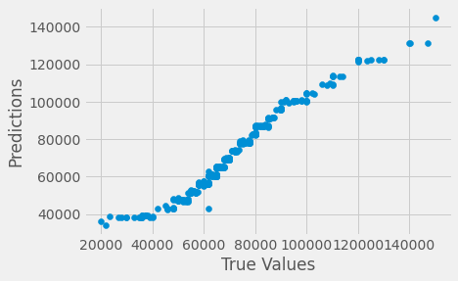
LINEAR REGRESSION model

Slide 11
CONCLUSION
Number of years of experience is the most important factor that determines salary
Company size is a

Slide 12
LIMITATIONS
Limited Data

Slide 13
REFERENCES
https://stats.stackexchange.com/questions/197923/difference-between-centered-and-uncentered-r2
https://www.analyticsvidhya.com/blog/2018/08/dimensionality-reduction-techniques-python/
https://statisticsbyjim.com/regression/predictions-regression/
Train/Test Split and Cross Validation in Python | by Adi Bronshtein | Towards Data Science

Slide 14

Contact details
Email:bethshogbanmu@gmail.com
Github: @beth-sho
LinkedIn url:linkedin.com/in/elizabeth-shogbanmu-20689756

